Slide 1

Intercultural Cooperation, Cultural Diversity and Sustainability
2201 - Fundamentals of Personal and Social Competence
Engineering for Sustainability (B.Sc.)
Faculty of Technology and Bionics
Rhine-Waal University of Applied Sciences
Team 05
Tifang Ngan Tata
Tadouanla Guetchuin Billy
Vaseekaran Sivaramanan
Sinthujan Gnanaseelan
Devon Ragel
38181
28177
38582
38307
37976
Cameroonian Cultures
Sri Lankan Cultures
Notes:
Good morning everyone,
Welcome to our presentation about intercultural cooperation, cultural differences, and sustainability perspectives between Sri Lankan and Cameroonian cultures.
Today, we will explore how cultural values influence communication, teamwork, leadership, and sustainable development in international environments.
These are the names of team members who contributed to the task.

Slide 2
Table of contents
3 | Introduction
6 | Countries & Cultural Background
9 | Visible vs Invisible Culture (Iceberg Model)
10 | Hofstede Cultural Dimensions
16 | SDGs & Sustainability
17 | Video Scenarios
19 | Conclusion & Discussion
Notes:
Before we begin, let me briefly guide you through the structure of today’s presentation.
First, we will introduce Sri Lanka and Cameroon by exploring their cultural backgrounds, traditions, and communication styles.
Second, we will analyze four Hofstede cultural dimensions and compare how they influence teamwork and professional cooperation.
Third, we will connect cultural values with sustainability and selected Sustainable Development Goals.
After that, we will present short intercultural video scenarios.
Finally, we will summarize our findings and open the floor for discussion.

Slide 3

Introduction
Q: How do cultural differences affect professional cooperation and teamwork?
Notes:
In today’s globalized world, people from different cultural backgrounds increasingly work and study together.
While diversity creates opportunities for innovation and learning, it can also create misunderstandings in communication, leadership expectations, teamwork behavior, and decision-making.
Therefore, our presentation focuses on how cultural differences affect professional cooperation and how intercultural understanding can support sustainability.
Now, let us begin with the country and cultural background comparison.

Slide 4
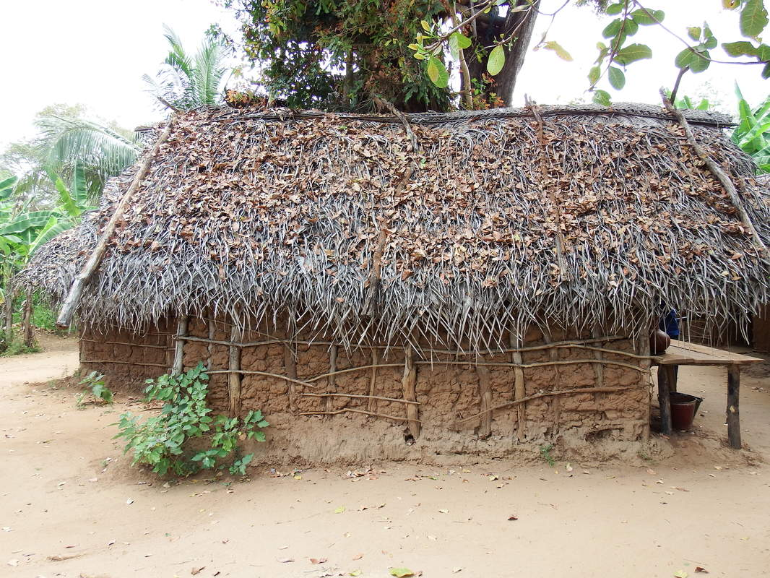
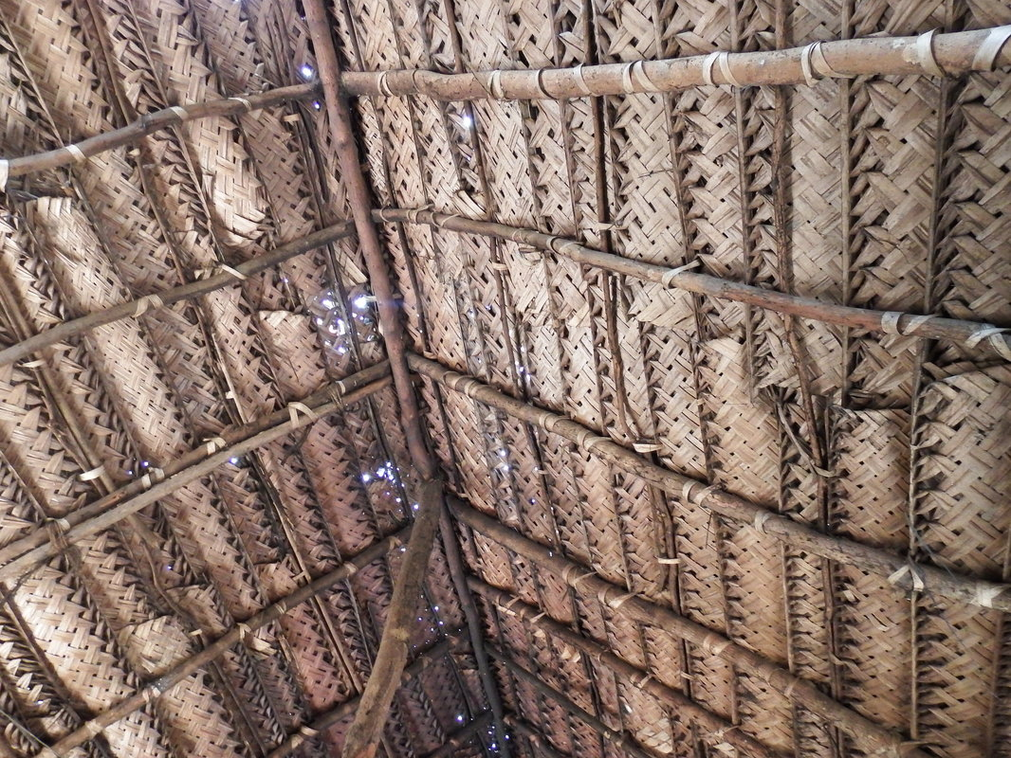
Sri Lanka
@https://whereinourworld.weebly.com/sri-lanka---inside-a-sri-lankan-home.html -
Notes:
Do you have any idea about how were the earlier houses in Sri Lanka?
Still these are in practice in many rural areas.
The walls are made of wattle and mixture of clay mud and cow dung.
The roofs are thatched with palm leaves.

Slide 5
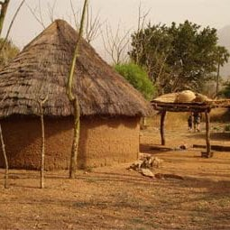
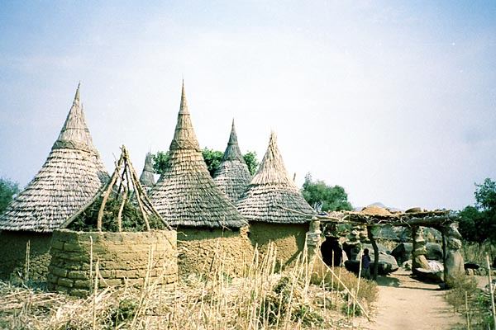
Cameroon
@Marina Rynkovskaya
@North; Gallery Cameroon
Notes:
How were the earlier houses and households in Cameroon?
Main Wall Material: Sun-dried clay mud (North) and Bamboo/Raffia palm (South/West)
Roof Style: Conical mud domes, or steep, dramatic bamboo/thatch pyramids

Slide 6
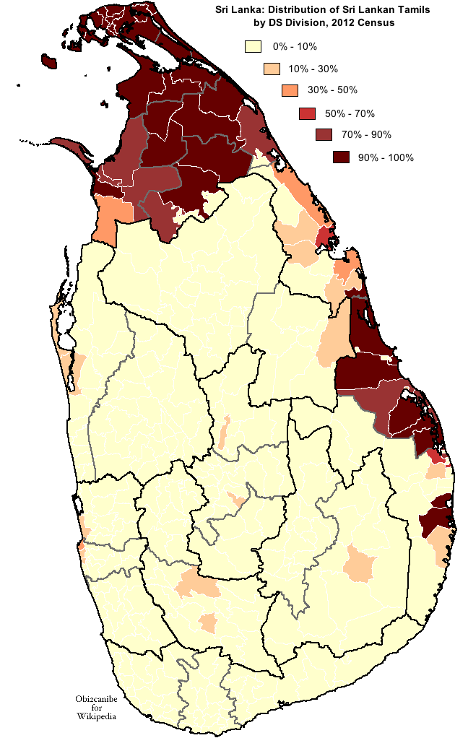
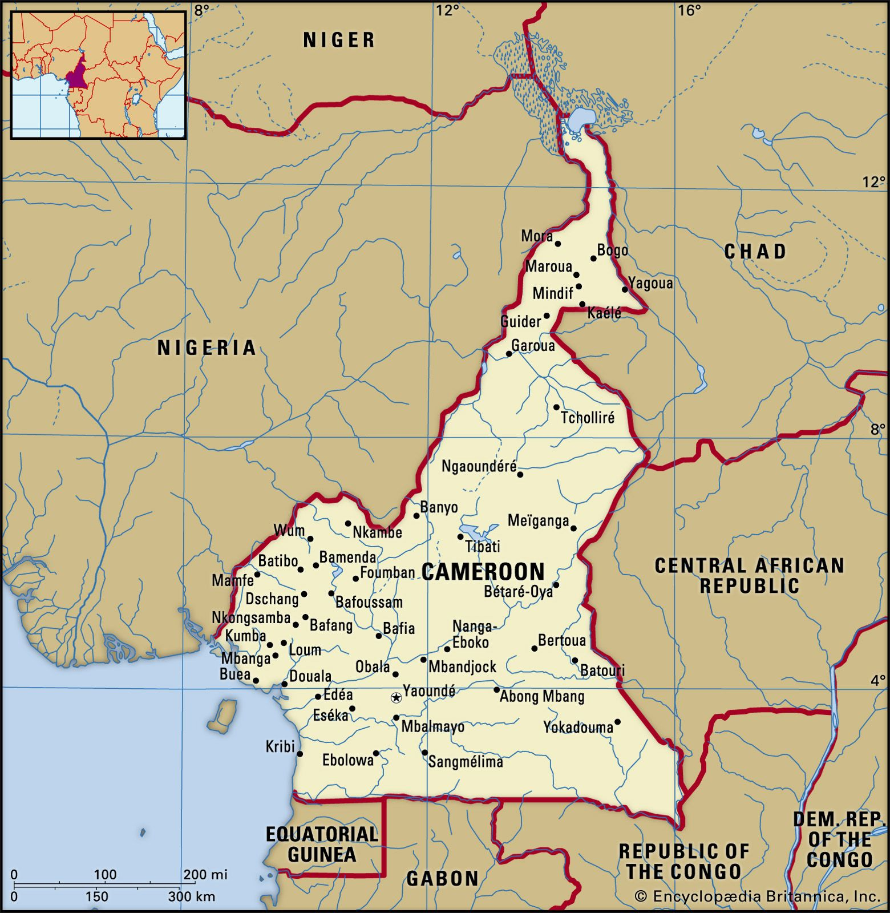
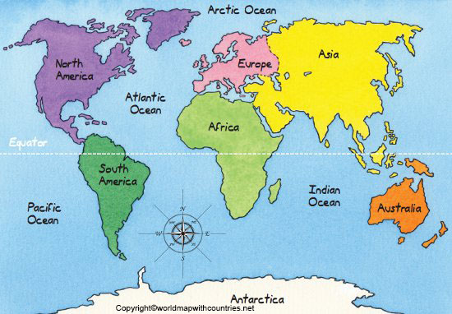
World Map & Country Locations
@Von Obi2canibe - Eigenes Werk
Notes:
Sri Lanka
South Asia
Population ~22 million
Sinhala & Tamil
Island nation also called “The Pearl of the Indian Ocean”
Cameroon
Central Africa
Population ~29 million
English & French
“Africa in miniature”
Common thing is both countries are situated almost similarly above and close to equator.

Slide 7
Sri Lankan Cultural Background
How

Slide 8
Cameroonian Cultural Background
How

Slide 9
Visible vs Invisible Culture (Iceberg Model)
How

Slide 10
Hofstede Model Introduction – Cameroon vs Sri Lanka
How

Slide 11
Individualism vs Collectivism – Cameroon vs Sri Lanka
How

Slide 12
Power Distance – Cameroon vs Sri Lanka
How

Slide 13
Motivation towards Achievement and Success – Cameroon vs Sri Lanka
How

Slide 14
Indulgence vs Restraint – Cameroon vs Sri Lanka
How

Slide 15
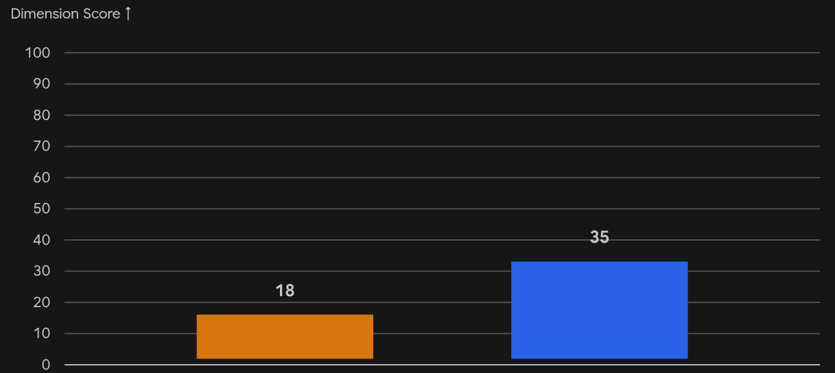
Applying Hofstede’s Framework: Cameroon vs. Sri Lanka
Individualism Vs. Collectivism
A clear 17-point delta; both are collectivistic, but Cameroon sits significantly deeper on the "We" spectrum.
Cameroon
Sri Lanka

Slide 16
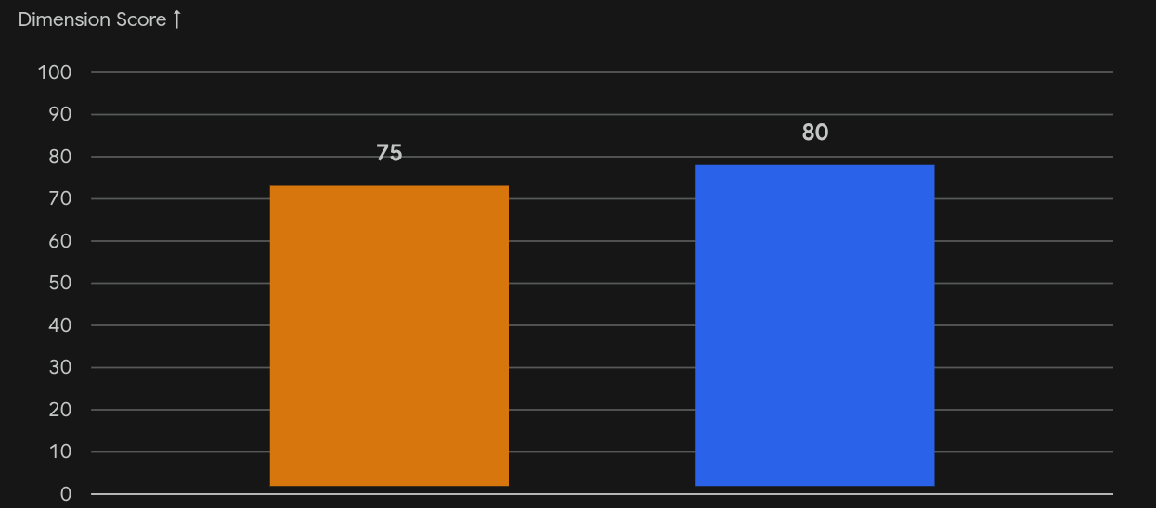
Applying Hofstede’s Framework: Cameroon vs. Sri Lanka
Power Distance
A minimal 5-point gap; both nations score highly, reflecting a shared natural acceptance of structural hierarchy and centralized authority.
Cameroon
Sri Lanka

Slide 17
Applying Hofstede’s Framework: Cameroon vs. Sri Lanka
Motivation towards Success
A dead heat with a 1-point difference; both countries occupy the exact same balanced, consensus-driven middle ground.
Cameroon
Sri Lanka

Slide 18
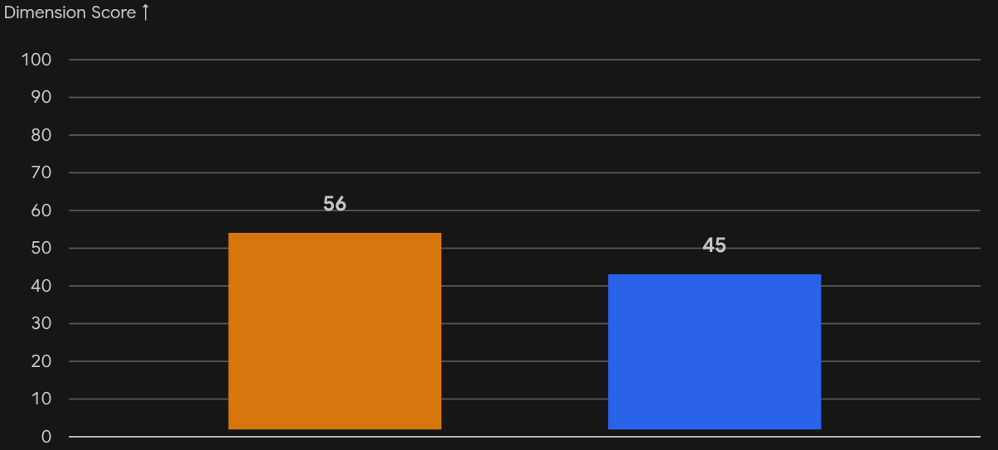
Applying Hofstede’s Framework: Cameroon vs. Sri Lanka
Indulgence Vs. Restraint
An 11-point variance; Cameroon crosses the threshold into Indulgence, while Sri Lanka leans slightly closer to Restraint.
Cameroon
Sri Lanka

Slide 19
Shaping Perspective: Everyday Life in Cameroon
The Foundation of Perception: Cultural identity isn't just a number on a graph; it is shaped by the unwritten rules of daily survival and celebration.
Example 1: The Njangi (Traditional Micro-Finance)
The Metric: High Collectivism in action.
The Reality: Community-pooled funds built entirely on mutual trust rather than formal, rigid banking contracts..
Example 2: Communal Celebrations & Street Vibrancy
The Metric: High Indulgence and Real-Time Adaptability.
The Reality: Major life events, music, and social gatherings are public, shared, and highly expressive experiences rather than strictly private affairs.

Slide 20
Shaping Perspective: Everyday Life in Cameroon

Slide 21
Culture & Sustainability - SDG
How

Slide 22
Video Scenarios - Cameroon
How

Slide 23
Video Scenarios – Sri Lanka
How

Slide 24
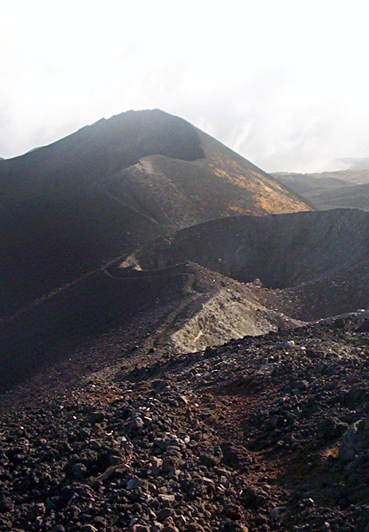
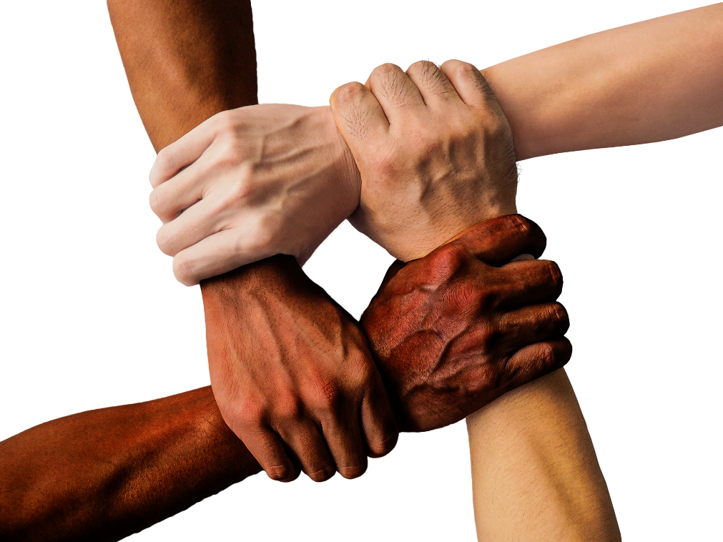
Cameroon: Mount Cameroon
Schedule Table
DAY 3
Conclusion
Intercultural understanding is essential for sustainable global cooperation.
@https://www.britannica.com/place/Cameroon#/media/1/90925/120740
Notes:
To conclude our presentation, we can clearly see that culture strongly influences the way people communicate, cooperate, solve problems, and make decisions.
Through the comparison between Sri Lankan and Cameroonian cultures, we identified both similarities and differences in areas such as hierarchy, teamwork, communication style, and social values.
Using Hofstede’s cultural dimensions, we learned that cultural expectations can shape behavior in universities, workplaces, and international teams. For example, differences in power distance may affect how people interact with leaders, while collectivist values may influence teamwork and group responsibility.
At the same time, we also understood that cultural diversity should not be viewed as a barrier. Instead, it can become a strength when people develop intercultural awareness, empathy, and respect.
Another important lesson from our research is the connection between culture and sustainability. Cultural values can either support or slow progress toward Sustainable Development Goals such as education, gender equality, and responsible consumption.
Therefore, achieving sustainability is not only a technological or economic challenge. It is also a cultural challenge.
For international students like us at Hochschule Rhein-Waal, intercultural competence is becoming increasingly important. In multicultural environments, successful cooperation depends on open-mindedness, adaptability, and mutual understanding.
Finally, our presentation highlights that sustainable global cooperation requires more than knowledge alone. It requires the ability to understand and respect different cultural perspectives.

Slide 25
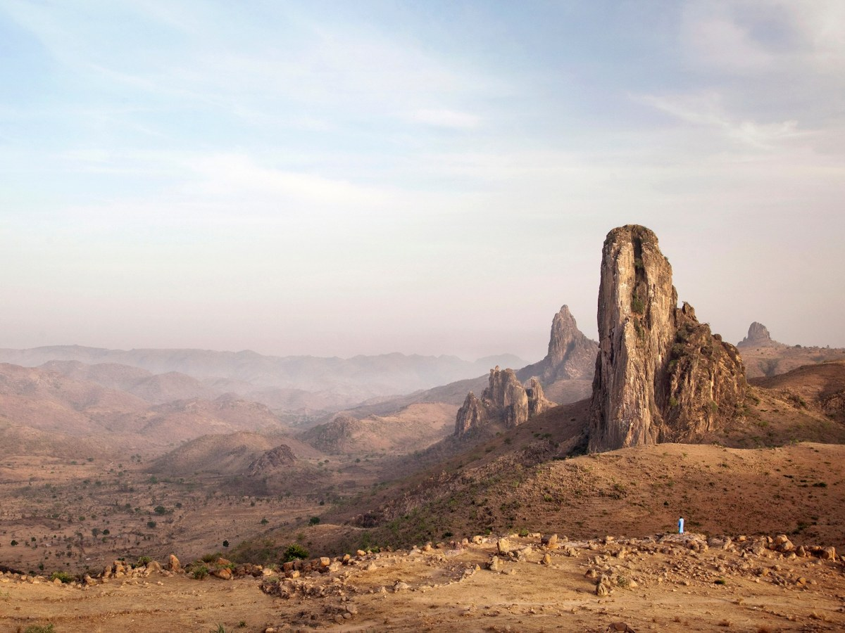
Cameroon: Mandara Mountains
Thank You
@https://www.britannica.com/place/Cameroon#/media/1/90925/120740
Notes:
Thank you very much for your attention.

Slide 26
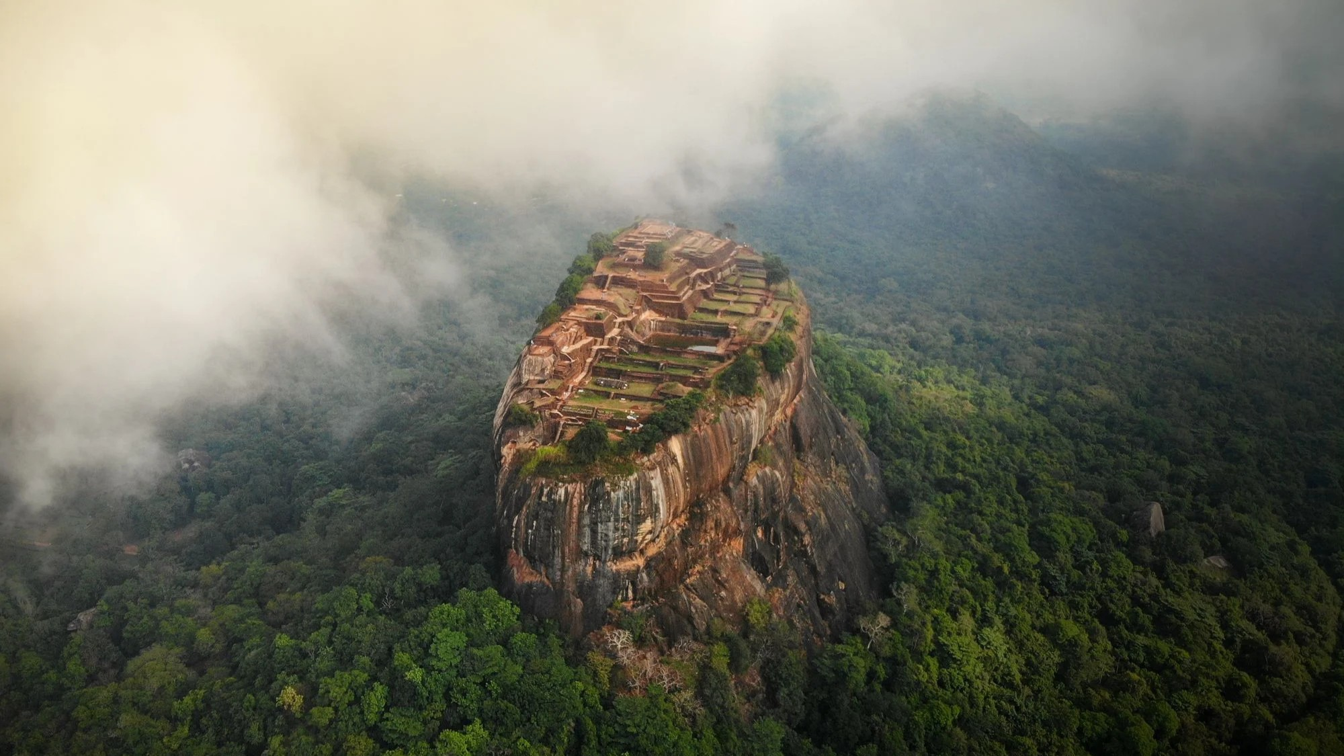
Questions & Discussion
Sri Lanka: Sigiriya – An UNESCO listed World Heritage Site
@Dani Redd
Notes:
We are now ready for your questions and discussion.

